Slide 1
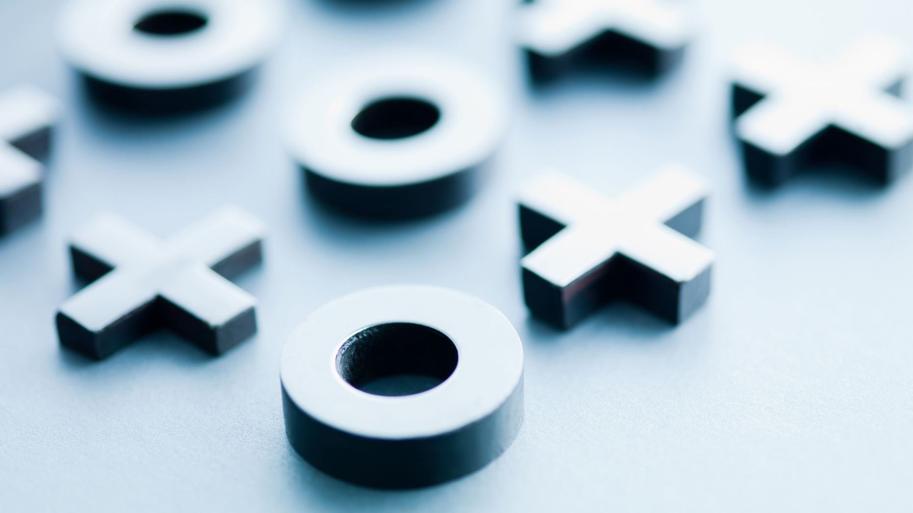

C++ Session 2
Functions and time complexity

Slide 2
Session’s Agenda
What’s a function?
Why we use functions?
Pre-defined or built-in functions.
User-defined functions.
Passing by value.
Exercises.
Algorithm analysis and time complexity

Slide 3
What’s a function? (20 minutes)
It’s a group of statements that together perform a specific task; and a block of code which only runs when it’s called.
Why a function?
A piece of reusable code.
Make the code shorter instead of repeating the same commands again.
You can use it whenever you want!

Slide 4
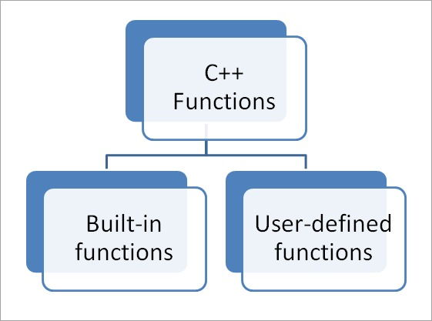
What are the types of functions?

Slide 5
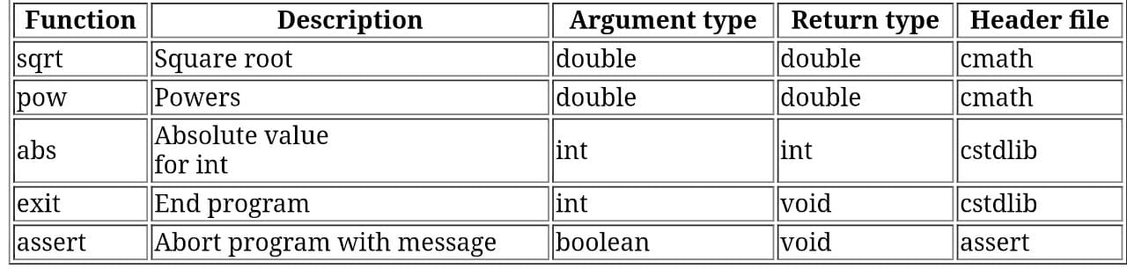
Pre-defined or built-in functions

Slide 6
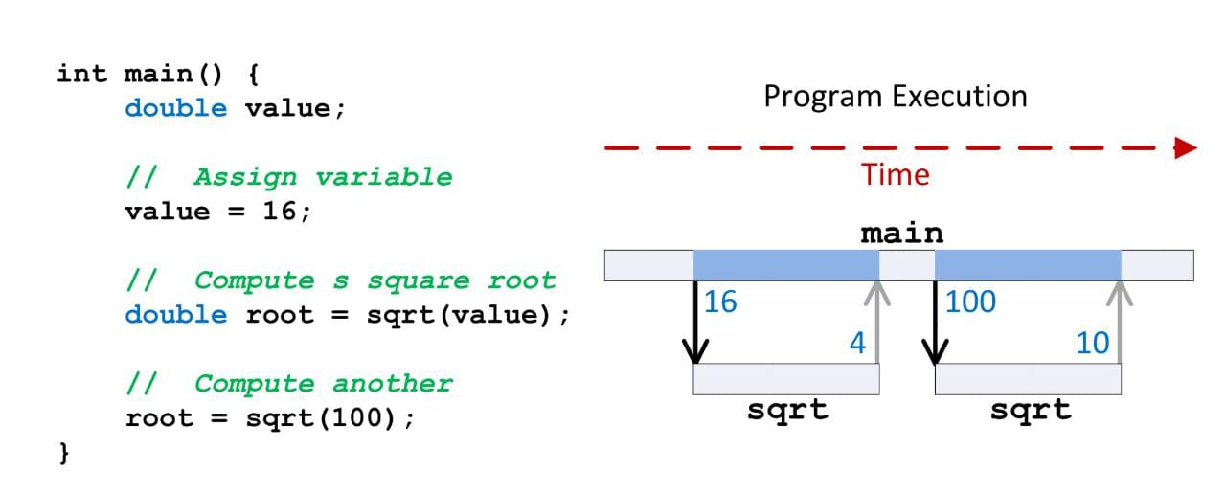
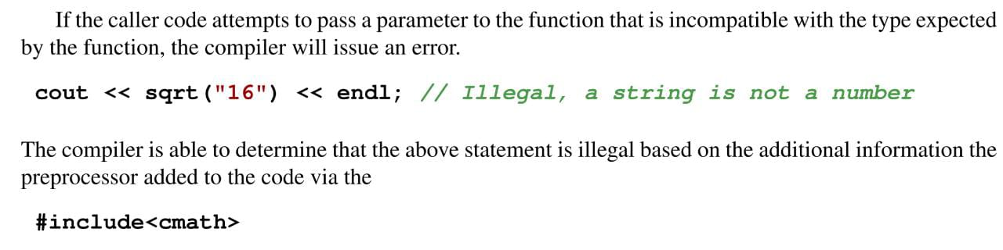
Examples on pre-defined functions
sqrt()
//one parameter

Slide 7
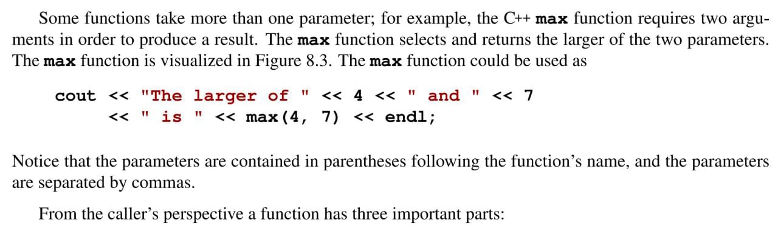
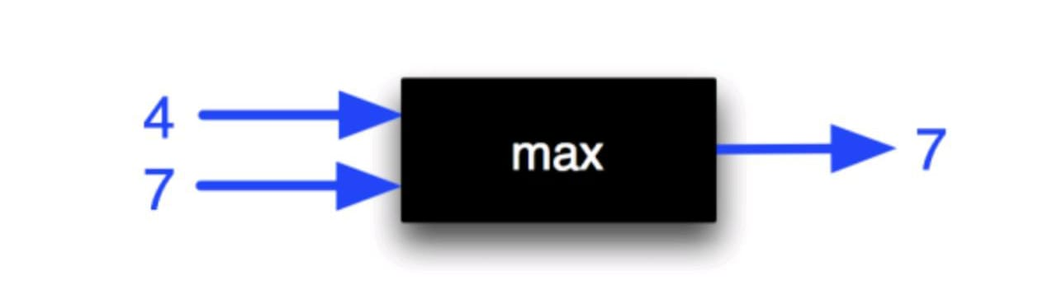
Examples on pre-defined functions
max()
//two parameters

Slide 8
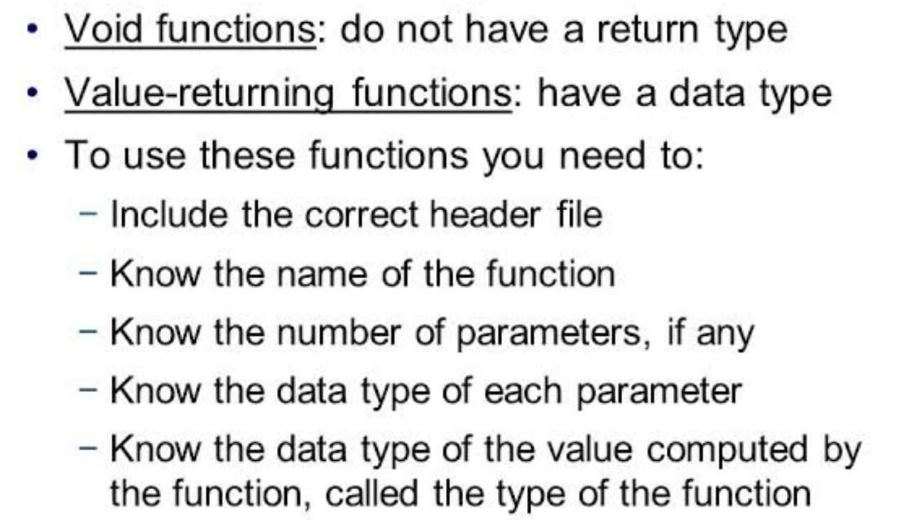
User-defined functions

Slide 9
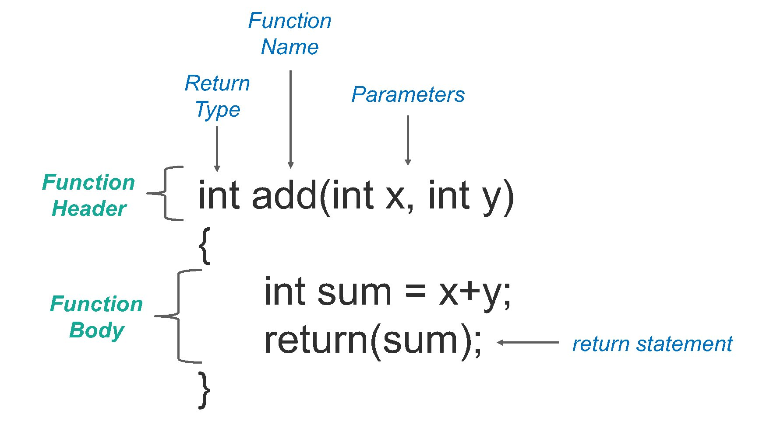
User-defined function’s syntax
The function is the standard unit of reuse in C++.
The code that uses a function is known as calling code.
Any C++ program should have at least one function which is the main().
However, the program can be compiled without it, but it cannot be executed!
Now, suppose you need to compute the square root of a number. Would it be a good idea to write a function to make that?

Slide 10
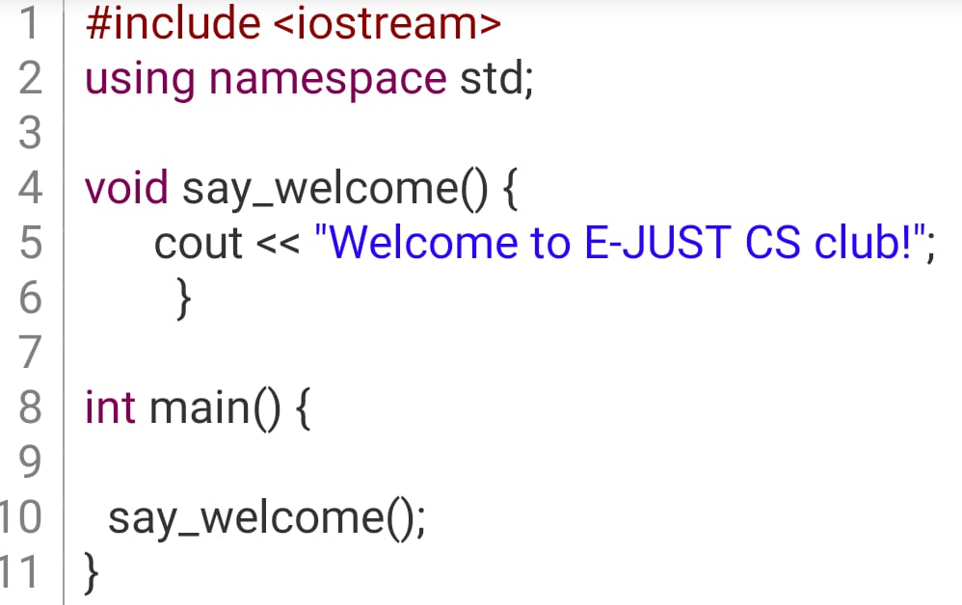
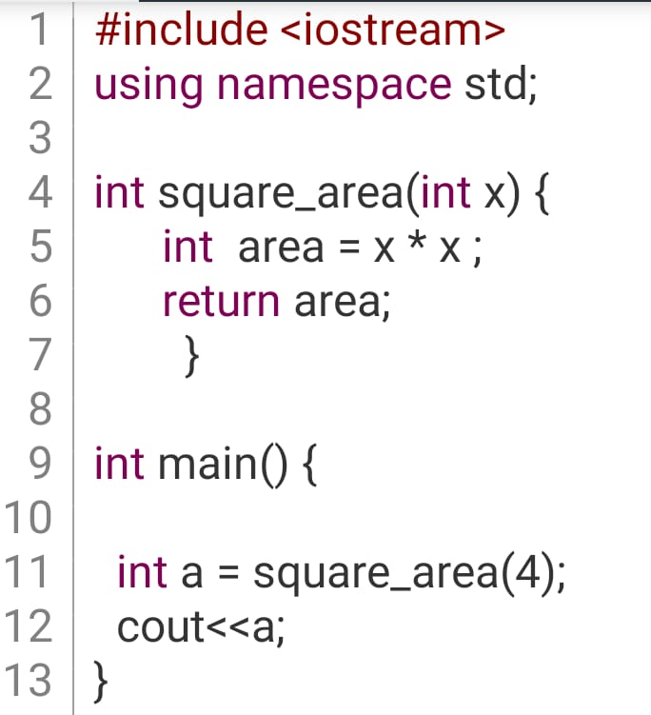
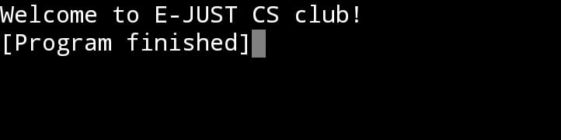
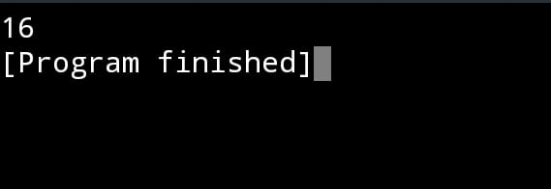
Examples on user-defined functions
A function with a welcome message
A function calculates a square’s area

Slide 11
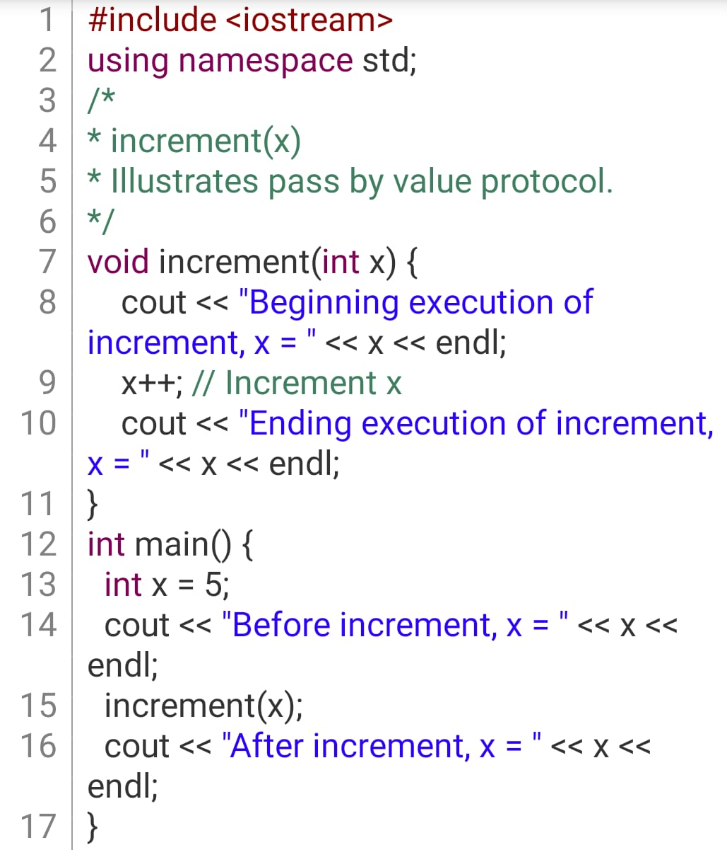
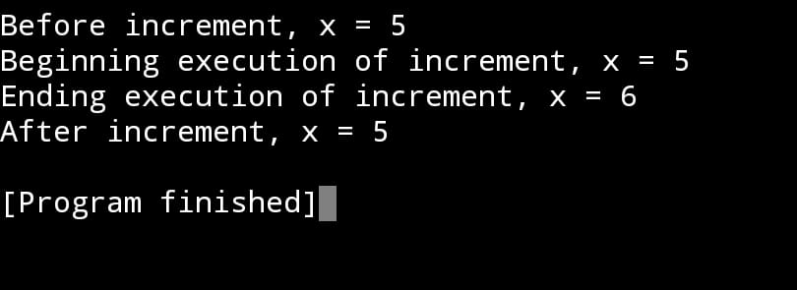
Passing by value
The default parameter passing mechanism in C++ is classified as pass by value, also known as call by value.
This means the value of the actual parameter is copied to the formal parameter for execution.

Slide 12
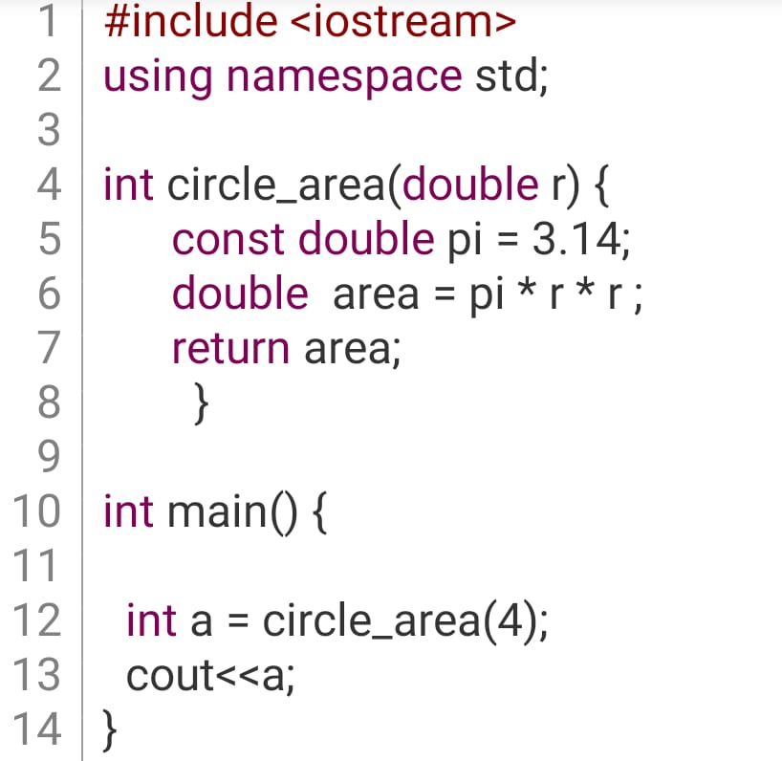
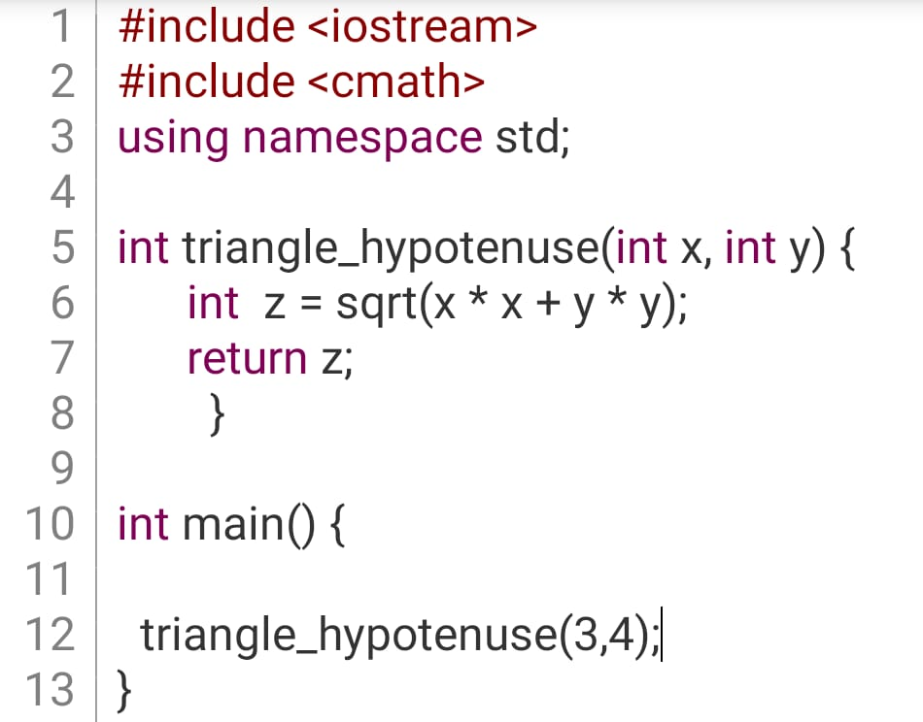
What’s the output of this code? (10 minutes)

Slide 13
What’s the output of this code? (10 minutes)
50.24

Slide 14
What’s the output of this code? (10 minutes)
50.24
5

Slide 15
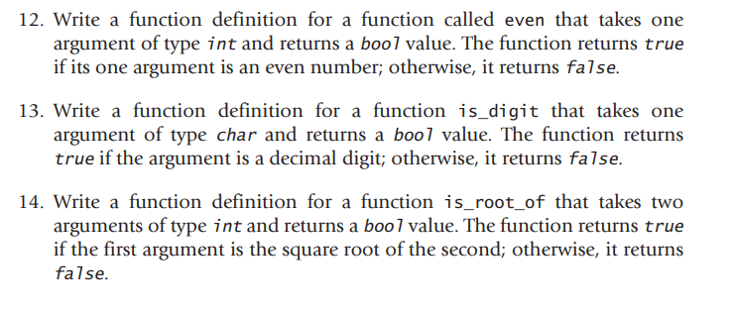
Can you solve this problem? (10 minutes)

Slide 16
Hint
To Know if the function is even or odd use %

Slide 17
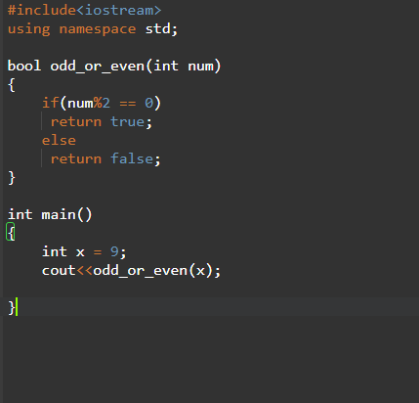
Hint

Slide 18
Let’s write more than one function! (15 minutes)

Slide 19
Let’s write more than one function! (15 minutes)
You can use Sqrt from cmath or check n*n

Slide 20
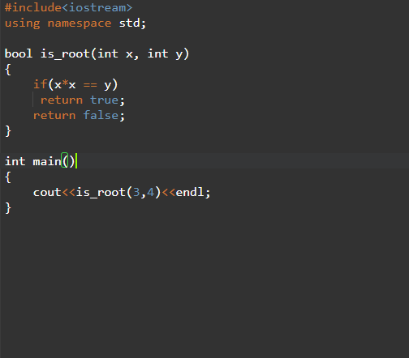
Let’s write more than one function! (15 minutes)

Slide 21
Let’s do more! (25 minutes)
create a function to print prime numbers between 1 and any number
Take the number from the user

Slide 22
Let’s do more! (25 minutes)
The Prime number is the number who only divide by 1 and itself.

Slide 23
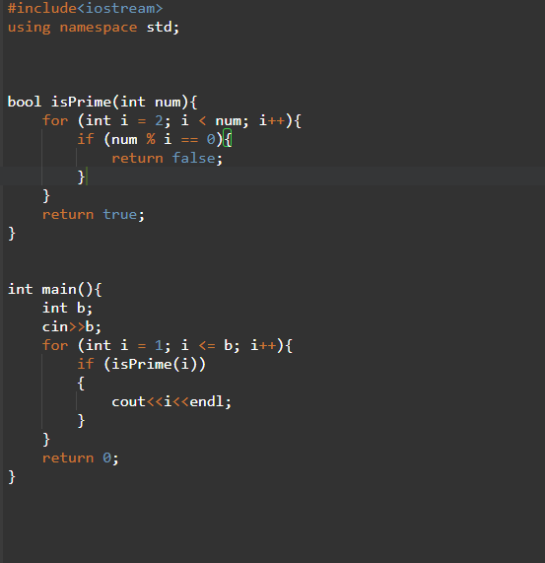
Let’s do more! (25 minutes)

Slide 24
Let’s do more! (25 minutes)
How do you think we can optimize the performance of this algorithm ??

Slide 25
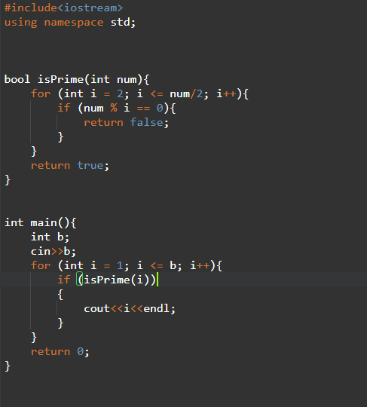
Let’s do more! (25 minutes)

